Slide 1
SENTIMENT ANALYSIS & PRODUCT RECOMMENDATION
by Serhat Tozar

Slide 2
Have you ever wondered how technology is reshaping our daily lives?

Slide 3
Did you know that over %70 of online shoppers rely on product recommendation before purchasing?

Slide 4
Some of you find it scary but some of us find it practical. It saves the most precious thing in our lives.
TIME.

Slide 5
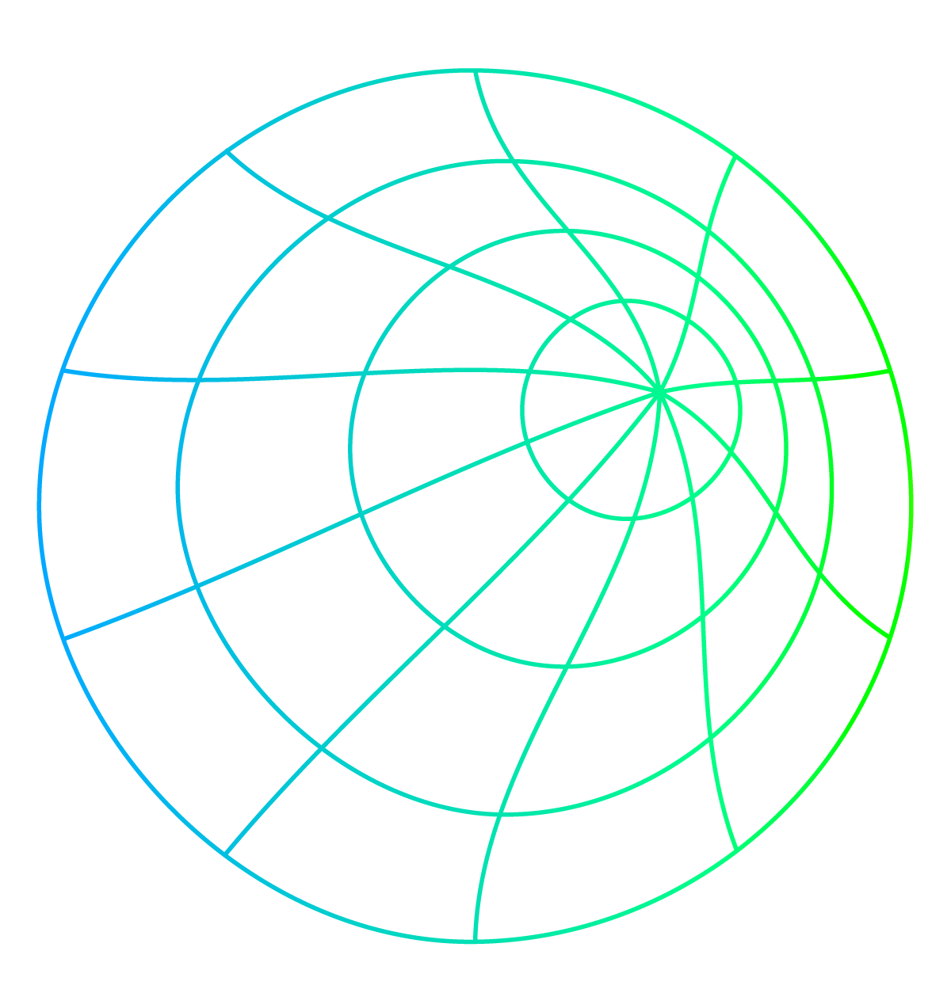
What is… What for… Where to use…
Sentiment Analysis
Product Recommendation
Sentiment analysis is the process of classifying whether a block of text is positive, negative, or, neutral.
I will use it to help the businesses and consumers to see the final results of reviews easily, instead of reading each review or counting stars.
Stars can be helpful as well but instead of 5 to10 rating scores,
I will deliver more sharp and clear answers with my model.
In this system, keywords are used to describe the items and a user profile is built to indicate the type of item this user likes. These algorithms try to recommend items that are similar to those that a user liked in the past, or is examining in the present.
With this system, my target will be both consumers and businesses: to give consumers a better chance to see things they would like to buy and give businesses more opportunity to display right products to sell for the right target groups.

Slide 6
AGENDA
DATA | Reviews Dataset for Sentiment Analysis + Restaurant Review Dataset for testing the model + E-Commerce Dataset for Product Recommendation
GOAL | Sentiment Analysis Model with the first dataset and on the extension of the project, using the vectorization this time for Product Recommendation
PLAN | Dataset research, applying goals, testing models, project delivery
STEPS | Data exploring, training data, testing the model, jumping on the next data using the vectorization again and go for product recommendation function and testing the system
LEARNINGS | After exploring how to use similarities on my NLP Sentiment Analysis, I discovered cosine similarity and use it on my recommendation system
CONCLUSION | DATA IS A JOURNEY! I will explain mine at the end of this journey, stay tuned!
For more info: labs/Sentiment Analysis Model + Product Recommendation.ipynb at main · serhatozar/labs (github.com)

Slide 7
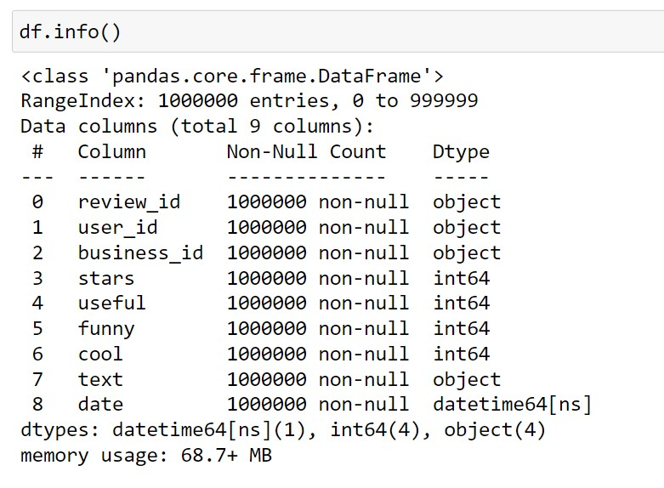
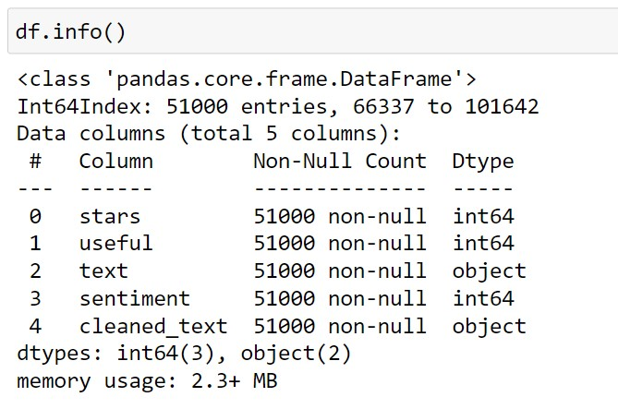
Yelp Reviews Dataset
.json file
1000000 chunk to 51K rows
9 columns to 5 columns
Incl.
Text (Reviews)
Stars (Ratings)
Useful

Slide 8
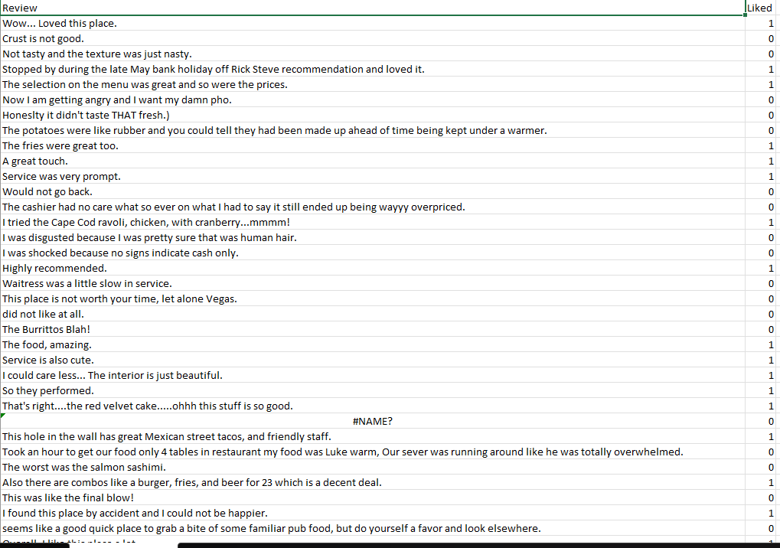
Restaurant Reviews Dataset
.csv file
1001 rows
2 columns
Incl.
Text (Reviews)
Liked (Ratings)

Slide 9
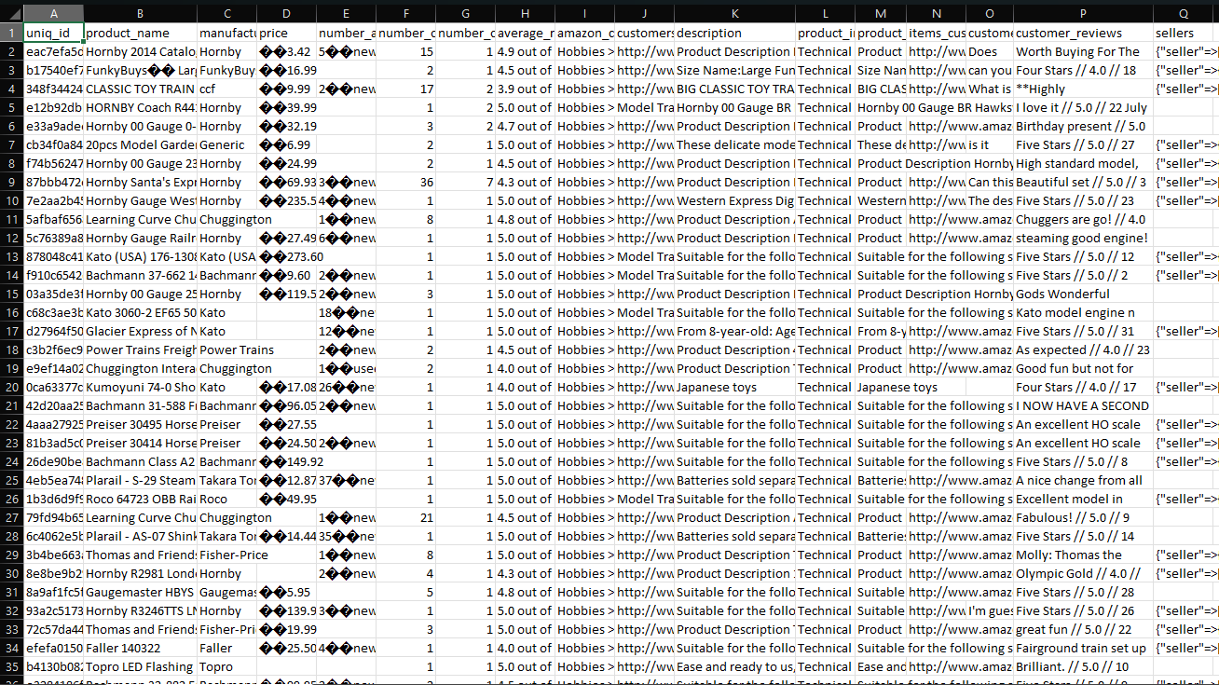
Amazon E-Commerce Dataset
.csv file
10003 rows
17 columns to 4 columns
Incl.
Product name
Description
Reviews

Slide 10
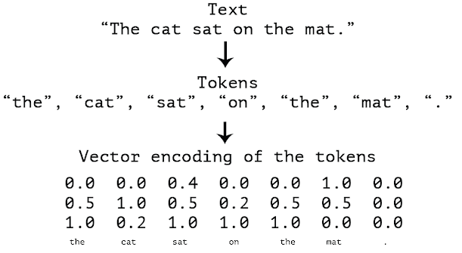
Information of actions before we start:
Tokenization: Tokenization is a fundamental step in Natural Language Processing (NLP) that influences the performance of high-level tasks such as sentiment analysis, language translation, and topic extraction. It is the process of breaking down text into smaller units, or tokens, such as words or phrases.
Vectorization : Vectorization is the process of converting words into numbers, it is a methodology in NLP to map words or phrases from vocabulary to a corresponding vector of real numbers which I will use to find word predictions, similarities etc.

Slide 11
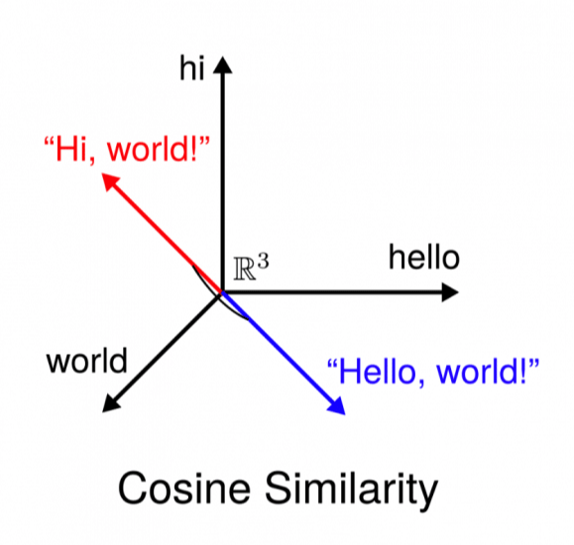
Cosine Similarity : Cosine similarity is widely used in data analysis and data science, particularly in the field of natural language processing. We often use cosine similarity in document retrieval systems where our goal is to find similar documents from a database.

Slide 12
Accuracy Treshold of Sentiment Analysis : The results proved to be much as expected. For opinionated texts, there is usually a 70% agreement between human raters. Thus, my model, which have accuracies around 70%, provide a very strong model for sentiment analysis.
References:
Queppelin Tech, NLP Report https://bit.ly/text_sentiment_analysis_based_on_NLP_works_for_businesses
Standard University, Jason Jang https://cs229.stanford.edu/proj2011/Jong-%20PredictingRatingwithSentimentAnalysis.pdf#:~:text=The%20results%20proved%20to%20be%20much%20better%20than,provide%20a%20very%20strong%20model%20for%20sentiment%20analysis.

Slide 13
PROJECT’S ARCHITECTURE
Test the Model
Classification Reports
Grid Searches
Yelp Dataset Preprocessing + Tokenization
Amazon Dataset Preprocessing
Vectorization
ApplyingSentiment Model +
Cosine Similarity
Get Recommendation Function
Test the Model

Slide 14
Sentiment Analysis Steps
01
04
05
02
06
03
RandomForestClassifier
Dataset
Vectorizing
Yelp Reviews Dataset
Loading the data and adjusting chunk
Words in Reviews to numerical values
Data Preprocess
Grid Search & Classification Reports
Cleaning the data
Defining star ratings as Sentiments
Fixing and equalizing the samples
Tokenization
Random Forest
Naive Bayes
Test the Model
Splitting Data to Test
Testing model on a different DataFrames and a dataset
Cleaned Text x Sentiment

Slide 15
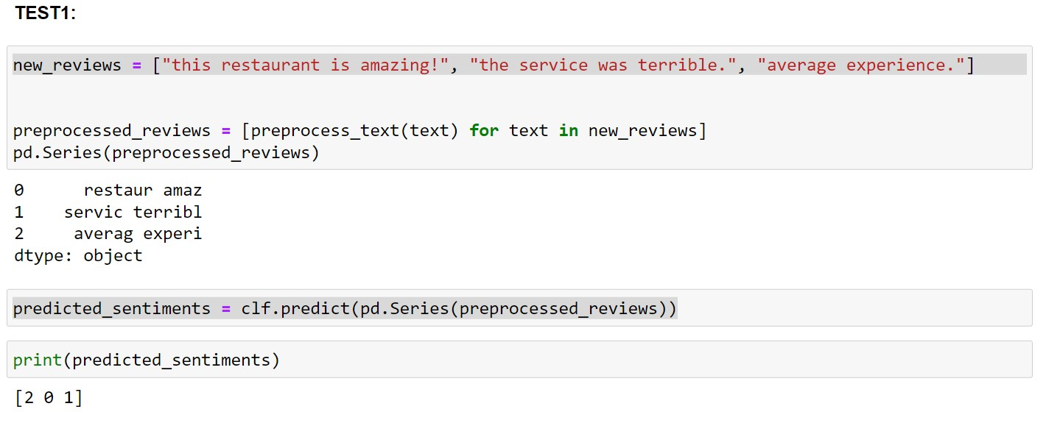
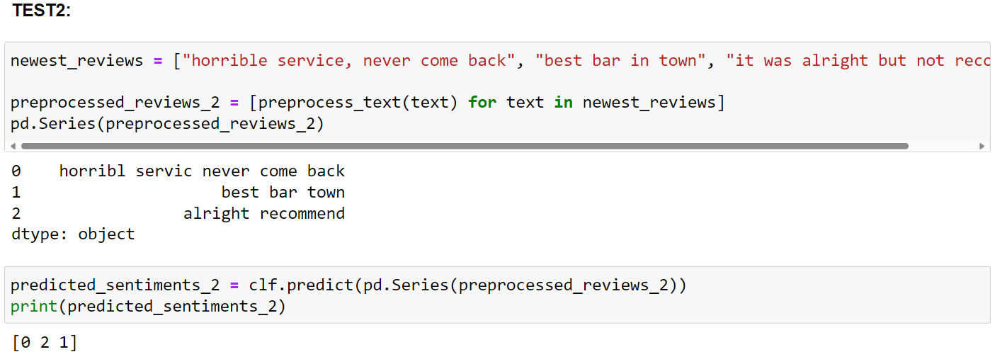
Positive Review = 2
Neutral Review = 1
Negative Review = 0
DEMO Please click on the link to try

Slide 16
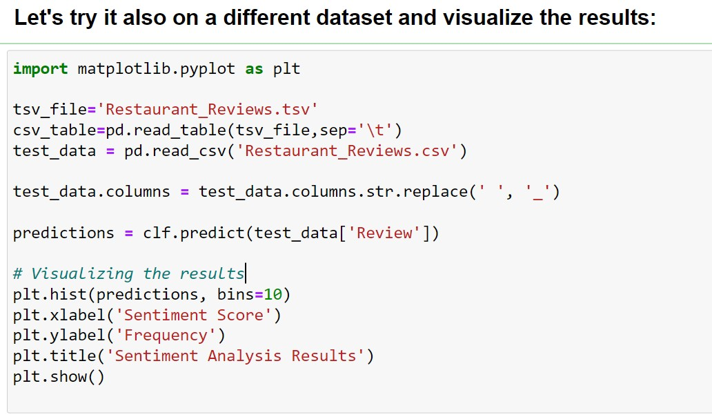
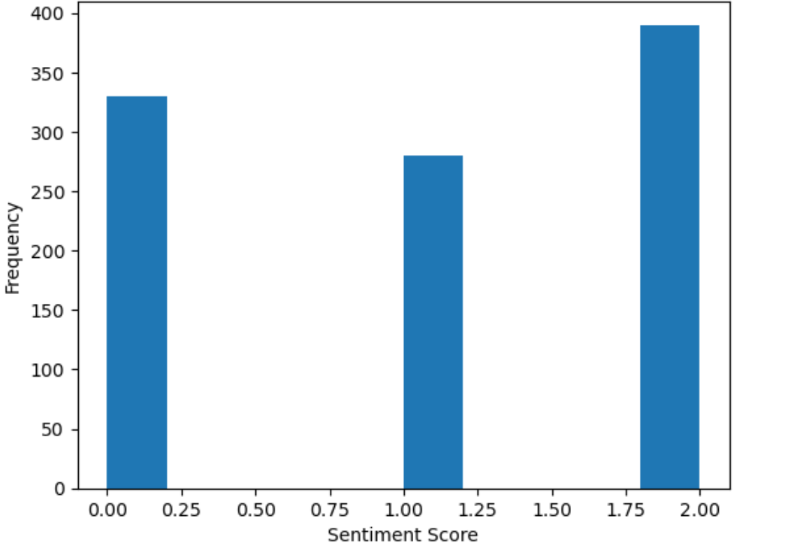
Positive Review = 2
Neutral Review = 1
Negative Review = 0

Slide 17
Product Recommendation Steps
01
04
02
05
03
06
RandomForestClassifier
Dataset
Applying the model
Amazon E-Commerse Dataset
Loading the new data
Checking the value types and applying the sentiment analysis model to the new dataset
Data Preprocess
Recommendation Function
Cleaning the new data
Adjusting the features
Cosine similarity measure the similarity and sim scores help to rank them. The function uses these scores to identify and suggest products
Vectorizing
Words in Reviews to numerical values. At this step cosine similarity gets in the picture with using the product descriptions to measure the similarities between products.
Test the Model
Testing the model to see your future favorite products!

Slide 18
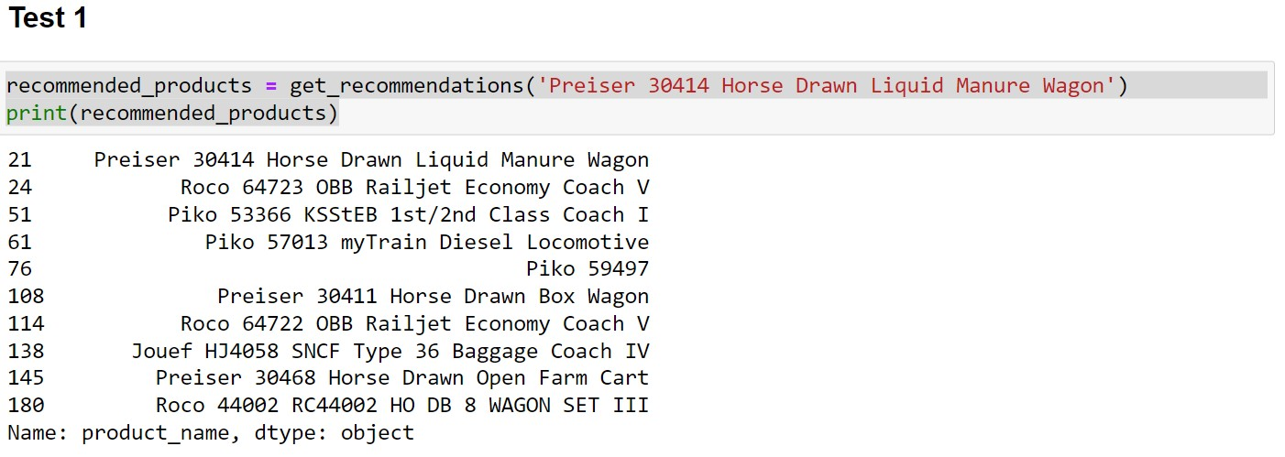
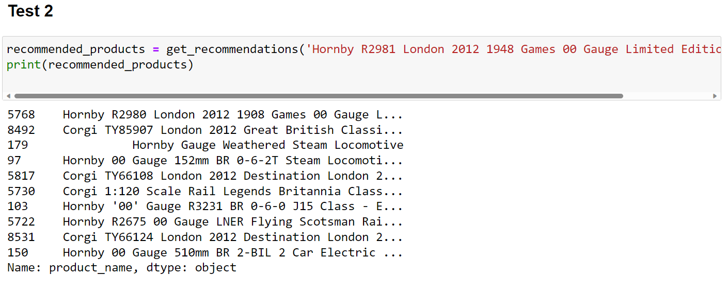
Positive Review = 2
Neutral Review = 1
Negative Review = 0
DEMO Please click on the link to try
Product sample from the dataset
Top 10 Product
Recommendations
Product sample from the dataset
Top 10 Product
Recommendations

Slide 19
PROGRESS TABLE
 | Test A | Test B | Test C
Sentiment Analysis
Product Recommendation

Slide 20
conclusion
Data is a journey!
It is very important to work with the right dataset and the tools to achieve your goal. In my case realizing the path was very related with the features. It was like a chain: starts with words, vectorizing them and ranking for different purposes. Both models can be used for different purposes but serving for a mutual purpose. Gaining time and having clear results for decision making for the businesses and the consumers.
I hope you enjoyed the journey!
Thank you

